Slide 1
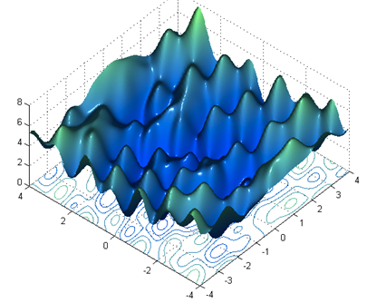
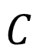
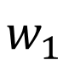
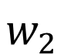
A key issue: the gradient descent and its variants never guarantee a global minimum
different initial weights
different minimum
L
loss

Slide 2
Learning Dilemma
loss
Very slow at the plateau and neighborhoods of attractors
Stuck at saddle points
Stuck at local minima
∇L(w)
^{≈ 0}
∇L(w)
⁼ ⁰
∇L(w)
⁼ ⁰
w space

Slide 3
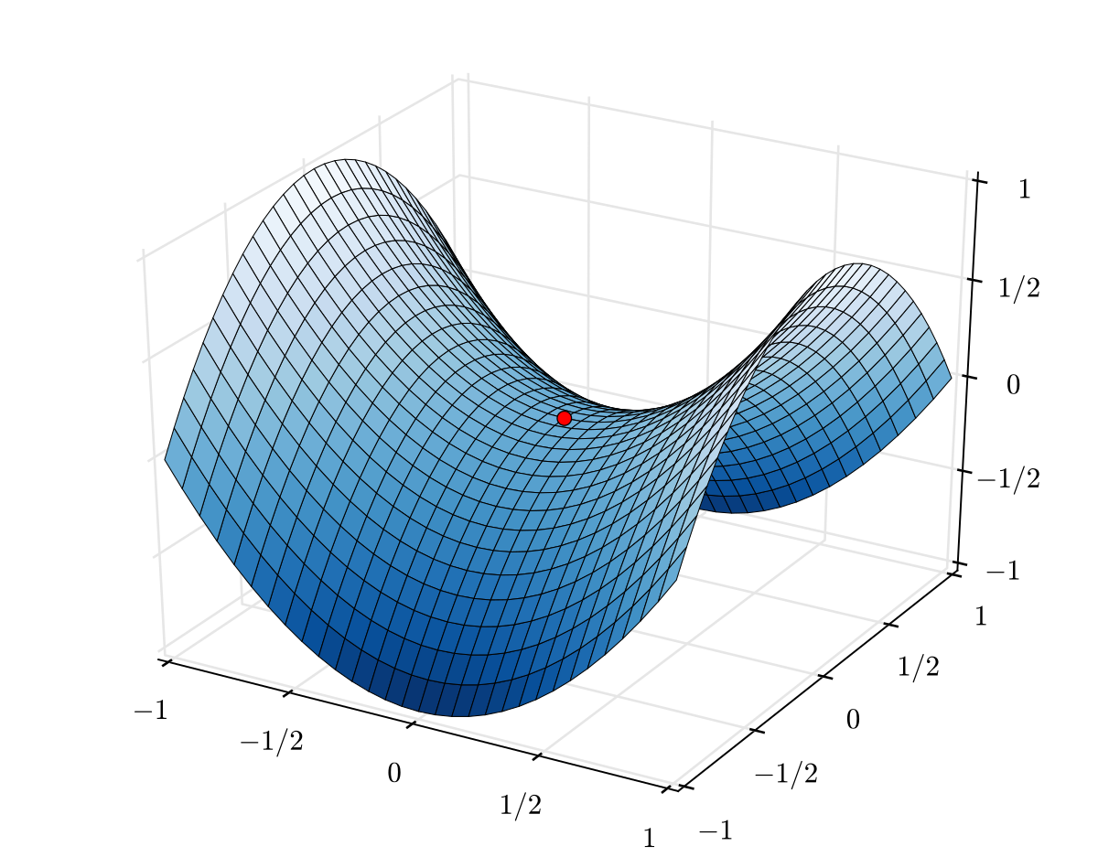
Saddle point (Saddle point - Wikipedia)

Slide 4

The learning processes on loss surface contours
https://towardsdatascience.com/types-of-optimization-algorithms-used-in-neural-networks-and-ways-to-optimize-gradient-95ae5d39529f

Slide 5

The learning processes on the saddle point
Reference:
https://en.wikipedia.org/wiki/Test_functions_for_optimization : Beale function
An overview of gradient descent optimization algorithms.pdf

Slide 6
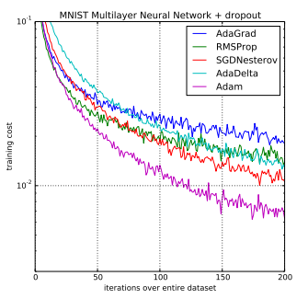
Comparison-of-Adam-to-Other-Optimization-Algorithms-Training-a-Multilayer-Perceptron

